Slide 1
DEPARTMENT OF ELECTRONICS AND COMMUNICATION ENGINEERING
REAL TIME BASED SOLDIER HEALTH MONITERING SYSTEM USING GPS AND GSM
by
B. Muralidhar Reddy (20AT1A0489)
Y. Nanda Krishna (20AT1A0493)
K. Raju (20ATIA04B4)
Under the Supervision of Mr. S. TOWSEEF AHMED, M. Tech., (Ph. D) Associate Professor
G PULLAIAH COLLEGE OF ENGINEERING AND TECHNOLOGY
(An Autonomous Institute affiliated to JNTUA, Ananthapuramu)

Slide 2
CONTENTS
Motivation
Objectives
Abstract
Introduction
Block diagram of Proposed method
Explanation of Block diagram
Software Used
References

Slide 3
Motivation
Enhancing Soldier Safety
GPS Integration
GSM Communication

Slide 4
objectives
To The system utilizes GPS technology to track the location of soldiers.
To The system uses GSM technology for seamless communication between soldiers and the monitoring center.
To The system can send immediate alerts to the monitoring center in case of any health emergencies.

Slide 5
ABSTRACT
Our system focuses on monitoring the health of soldiers in real-time. We utilize GPS (Global Positioning System) and GSM (Global System for Mobile Communications) technologies to create an efficient and effective monitoring solution. This system ensures that soldiers' health conditions are constantly tracked and communicated to a central control station. By combining GPS for location tracking and GSM for communication, our solution enhances the safety and well-being of soldiers during their missions, allowing timely intervention in case of any health-related issues.

Slide 6
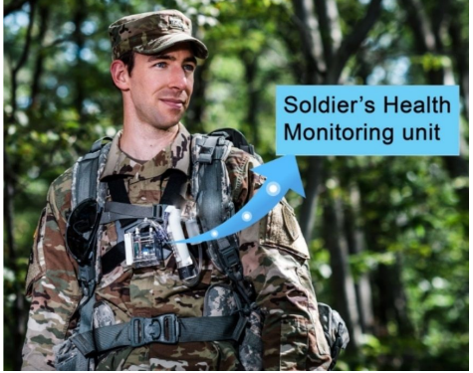
INTRODUCTION
Soldier unit:
Military service are rapidly adopting new inventions and innovations. Army forces are crucial in warfare and their physical health matters as they defend the nation from enemies
Soldier well-being is essential. Protecting them involves tracking their location and movement. This helps the base station ensure their safety and plan effectively.

Slide 7
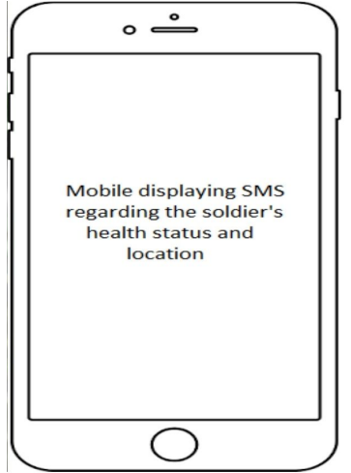
INTRODUCTION
Base unit:
Our project aims to track soldiers' precise locations and monitor their physical health during combat. This information will empower the base station to adapt war strategies accordingly.
The focus of our paper is on utilizing GPS technology to accurately track army members. This system offers valuable insights to the base camp, aiding in the real-time identification of soldiers' health status and positions.

Slide 8
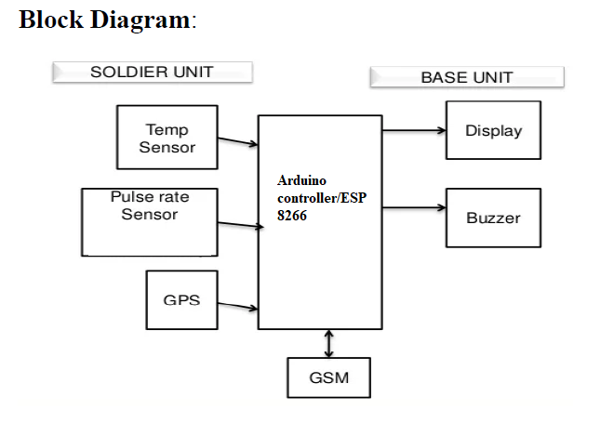
PROPOSED block diagram

Slide 9
Explanation of block diagram
It consists :
Power supply
Temperature sensor
Panic Button
Microcontroller
GSM and GPS
Heartbeat sensor
LCD

Slide 10
Explanation of block diagram
Transmitter:
Components: power supply board with Bridge Rectifiers, Capacitors, Resistors, and PIC16F877A microcontroller.
Function: Collects data from GPS, GSM, and biomedical sensors (pressure, oxygen, heart rate, temperature).
LCD Display: Displays "Soldier Health Monitoring System" during startup.

Slide 11
Explanation of block diagram
Sensor Data: Each sensor provides measurements.
Threshold Logic: If sensor values are within threshold, display "N" (normal), otherwise "H" (high) and alert predefined contacts.
Receiver:
Components: Cell phone with SIM card (receives messages), base station.
Function: Receives soldier's messages and alerts from transmitter.

Slide 12
Explanation of block diagram
Alert Message: If sensor values are abnormal or soldier initiates a danger alert, a message is sent.
Data Interpretation: Normal/abnormal status and danger alert are indicated.
Communication: Cell phone receives messages, processes alerts, and communicates with the base station.

Slide 13
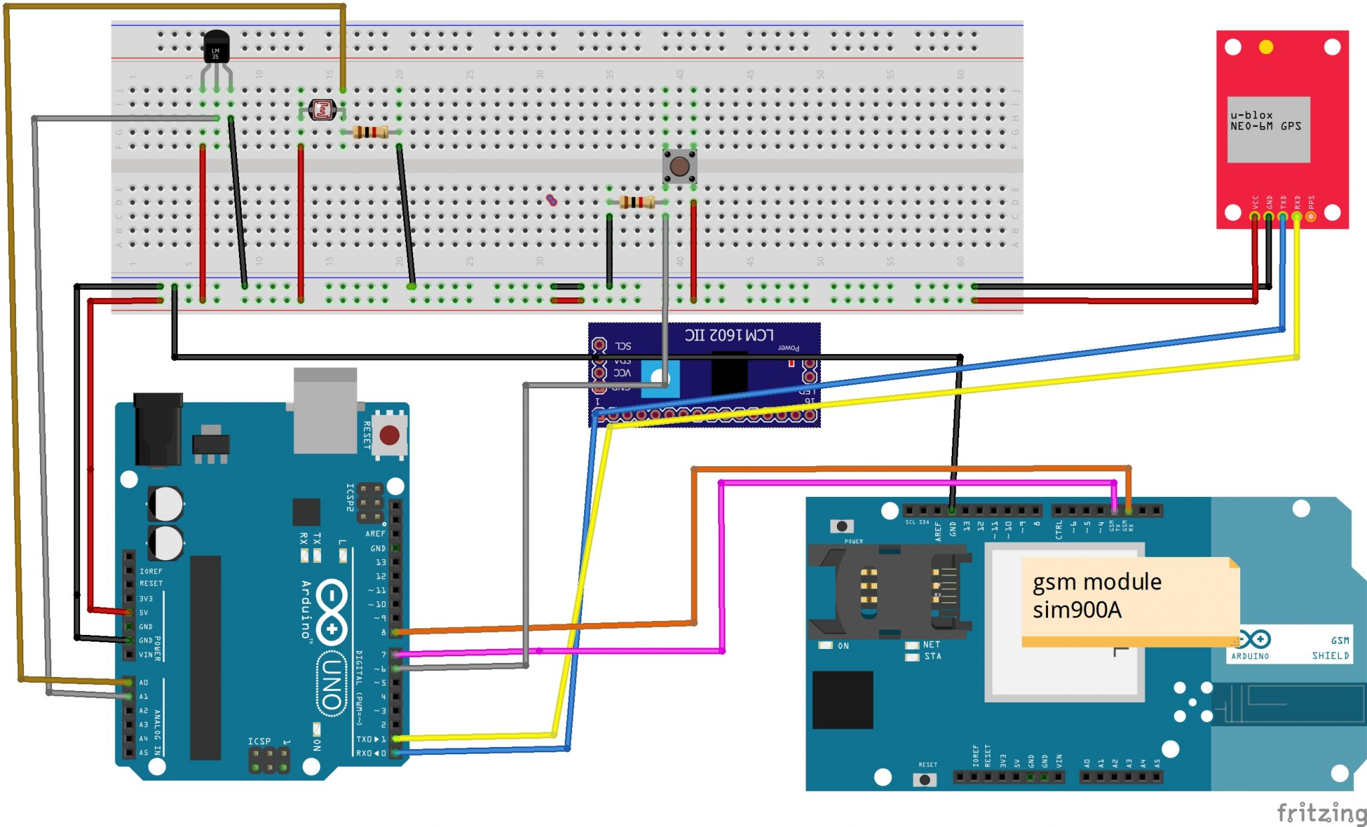
PROTOTYPE OF THE PROJECT

Slide 14
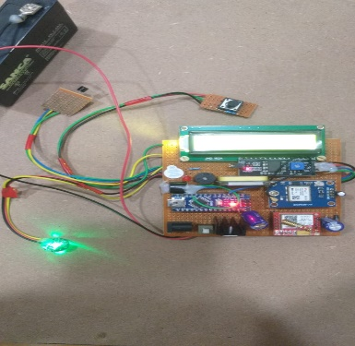
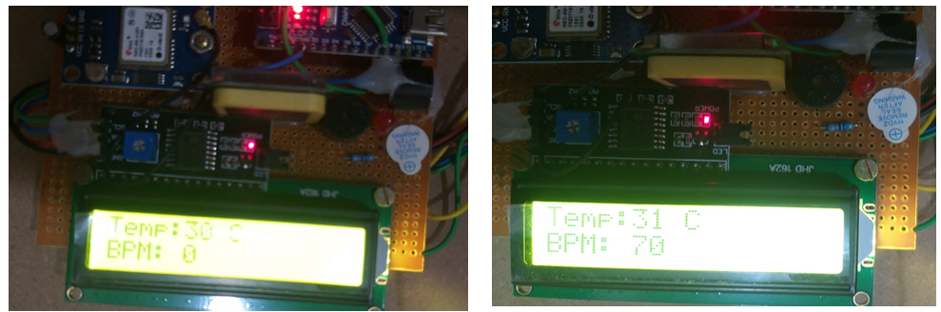
RESULTS
Soldiers wear sensors that monitor their health and location. These sensors track things like heart rate and activity levels. They're connected to a GPS that shows where each soldier is. All this data is sent wirelessly using the GSM network to a text message to mobile on each soldier's device.

Slide 15
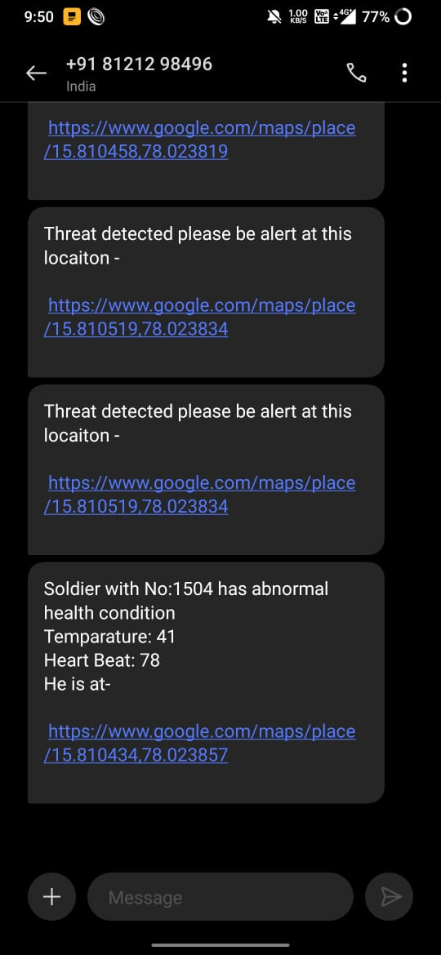
RESULTS
This app lets soldiers see their health info in real-time. All the soldier data goes to a central command center, which is connected to a server. The server stores and analyzes the data. Visualization tools help commanders understand the info better. If something goes wrong, like a soldier gets hurt, the system sends alerts to commanders so they can help.

Slide 16
CONCLUSION
The Army Healthcare and Location Tracking GPS program is a key safety and protection feature that combines electronic and wireless automation. We conclude that the above system is used to monitor the physical health of soldiers using the heart rate sensor, temperature sensor, pressure sensor and oxygen sensor. This method is also useful for soldiers in war because if they think they are in a critical situation, they can ask for help from the base station by pressing the button on the base station. Our scheme also sends Details about the location and intent of the SMS to the base station. Our plan will provide greater security for our warriors by connecting the gas detector to the appropriate sensor station.

Slide 17
CONSLUSION
Interconnecting a camera to the controller might also help in this procedure. Once the above process is completed, it will help determine the health of soldiers by measuring heart rate and body temperature. It will also help in tracking its location using a GPS Modem and through a GSM Modem it will be able to send all the data to the base station for further processing.

Slide 18

SOFTWARE TOOL USED
The Arduino UNO IDE is a software development environment used for programming Arduino boards. It allows users to write, compile, and upload code to their Arduino devices. It supports a simplified programming language based on C/C++.

Slide 19
refErences
Arya V Nair, Rani Raju, Tinsa Elsa Thomas and Vidya R Nair, “IoT Based Soldier Monitoring System” ,Pramana Research Journal,Volume No:9, Issue:5, pp: 157-165,2019.
Brijesh Iyer and Niket Patil, “IoT enabled tracking and monitoring sensor for military applications”, International Journal of Systems Assurance Engineering and Management, SPRINGER, July-2018.
D. Poornakumar, R. Periyanayaki, M. R. Pradheepa, N. Prakashkumar and S. Nandhini ,“Soldiers Navigation and Health Monitoring System using GPS and GSM”, International Journal of Research in Engineering Science and Management, Volume No: 3,Issue:4,pp:115-158,April-2020.

Slide 20
QUERIES?

Slide 21
THANK YOU

